Slide 1
10th Grade Counseling Orientation
NAI - 2023-2024

Slide 2
NAI Counseling Department
Where is the Counseling office?
The Counseling Office is located at the top of the stairs, from the Cafeteria, in A hall.
How do I know who my counselor is?
Students are assigned to counselors by their first letter of their last name.

Slide 3
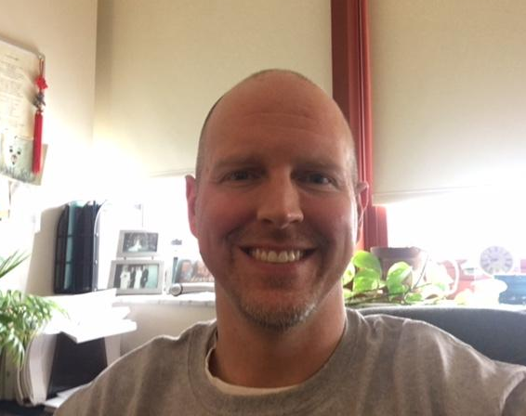
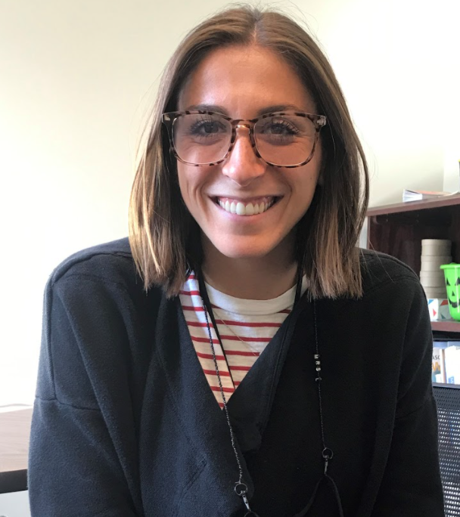
Meet the NAI Counselors
Mr. Kiggins, A - Dn bkiggins@northallegheny.org
Mrs. Lewis, Do - J
mlewis@northallegheny.org
Notes:
Maddie

Slide 4
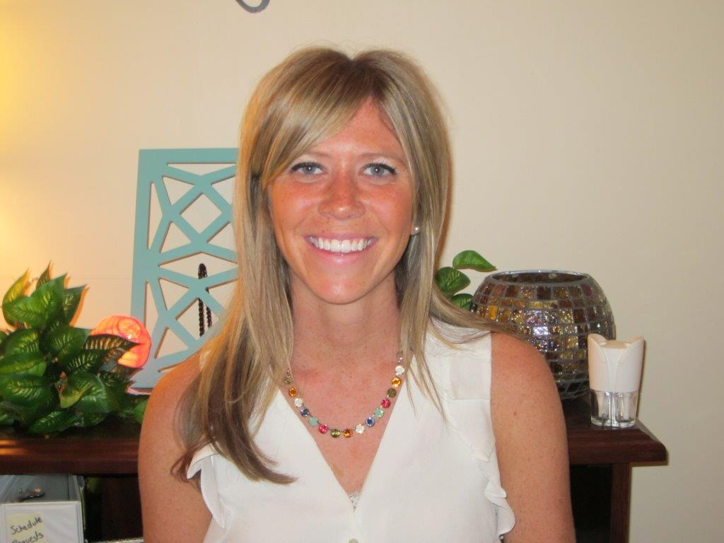
Meet the NAI Counselors
Mrs. Mayhew, K - M
mmayhew@northallegheny.org
Mr. Butler, N - Sh
mbutler@northallegheny.org
Notes:
Maddie

Slide 5
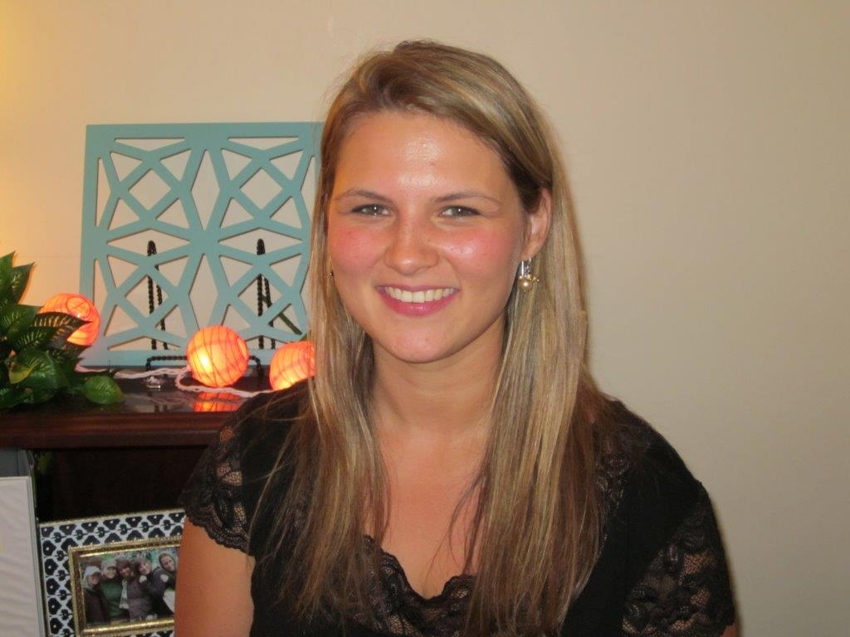
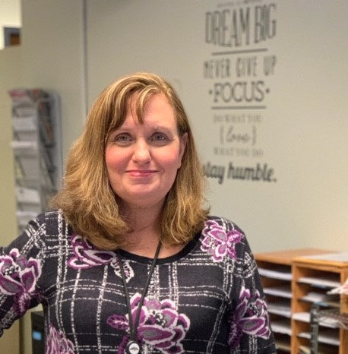
Meet the NAI Counselors
Mrs. Liebenguth, Si - Z
rliebenguth@northallegheny.org
Ms. McLeod
Counseling Department
Secretary
412-369-5464
Notes:
Maddie

Slide 6
How To Meet With Your Counselor
If you need to speak with your counselor, you may stop by the counseling office or e-mail them to set up a time to meet in person.
Mr. Kiggins - bkiggins@northallegheny.org
Mrs. Lewis - mlewis@northallegheny.org
Mrs. Mayhew - mmayhew@northallegheny.org
Mr. Butler - mbutler@northallegheny.org
Mrs. Liebenguth - rliebenguth@northallegheny.org

Slide 7
NAI 10th Grade Course Sequence
Required
English 1.0 credit
World Cultures 1.0 credit
Math 1.0 credit
Science 1.0 credit
Physical Education 0.5 credit
Wellness 0.5 credit (if not taken in 9th)
Total 4.5/5.0 credits
Elective Courses: up to 3.0 credits (must schedule at least 2.0 credits)
**Students must take a minimum of 7 credits and a maximum of 8 credits.

Slide 8
Other Important Topics
Transcripts
NCAA
North Allegheny E-mail
PowerSchool STUDENT Portal

Slide 9
NEED HELP?
TEACHERS! TEACHERS! TEACHERS!
Subject area tutoring
Northland Library Online Tutoring
Connect with your counselor about other supports

Slide 10
Personal Counseling

Slide 11
Group Counseling
Coping with Loss
Coping with Changes in your Family/Stepfamily
Concerned Person’s Group
Handling Stress
Improving Personal Relationships
Why do I Feel Sad? What Can I Do?
Eating Concerns (Anorexia, Bulimia)
Insight Into Chemical Use
Aftercare for Recovery
Coping with Anger
Quit Smoking
New Student Group
Boys/Girls Group
***if you are interested in any of these possible groups, please e-mail your counselor***

Slide 12
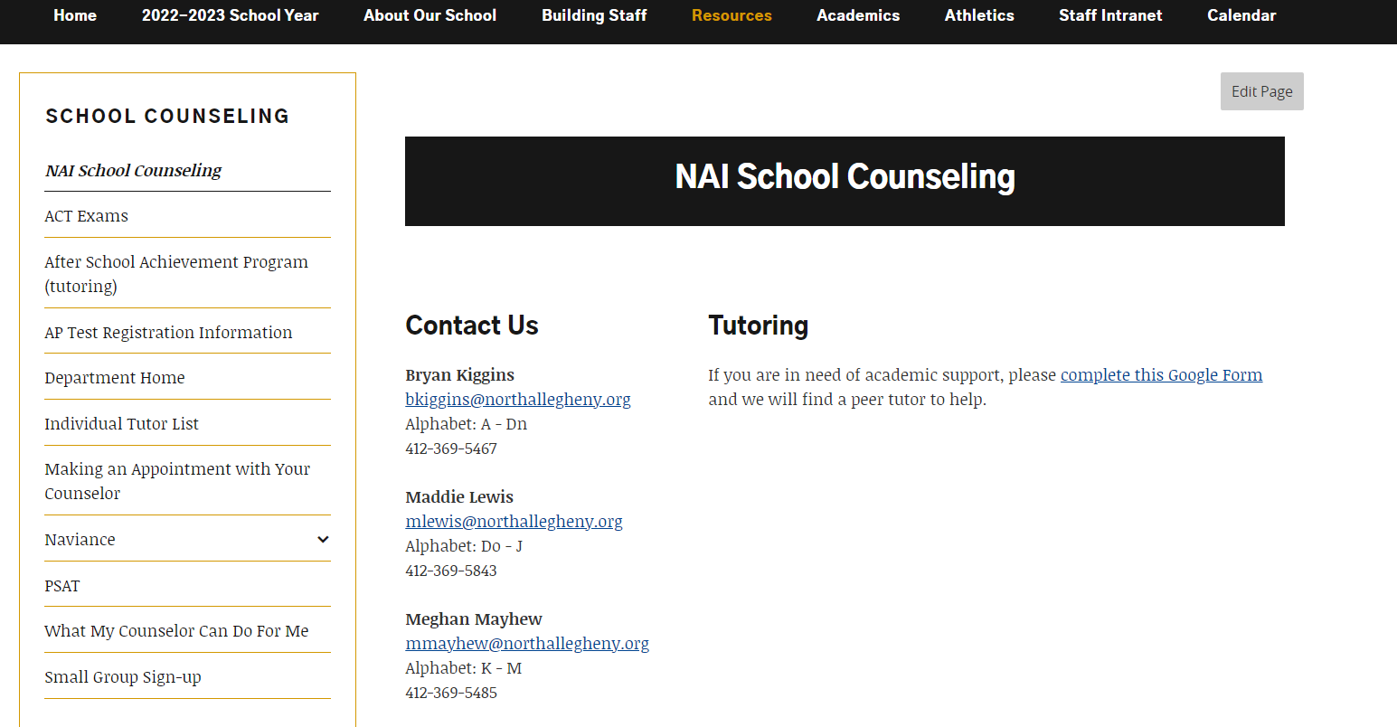
SSmall Group Google Link

Slide 13
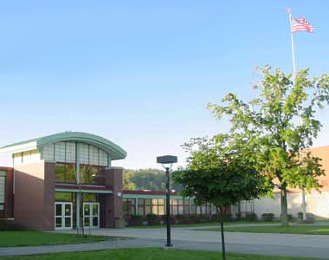
Pre-ACT
-information will be shared through Naviance
-Pre ACT will be on
Saturday, January
20th at NAI

Slide 14
PSAT
-PSAT is currently open to 11th grade students ONLY
-Listen for announcements on October 3rd and October 6th regarding available spots for 10th grade students
-You may pick up a registration form in the counseling office. Spots will only be available depending on 11th grade registration.

Slide 15
Welcome to Naviance
Naviance is a web-based resource for students and parents that encourages and supports post high school career and college planning.
Family Connection is specific to our school.
Family Connection is linked with Naviance Succeed, a service that is used in School Counseling.

Slide 16
How Can I Use It?
Career Planning
Learning Style Inventory, Interest Inventory, Personality Inventory, Resume Building
College Planning
College Search, Application Process, College Major Exploration, Scholarship/Financial Aid Resources
Success Planning
Personalized Goals and Tasks, Journal Entries, Student Planner

Slide 17
Getting Started - Naviance
***Login to Naviance through your TIGER ID portal***

Slide 18
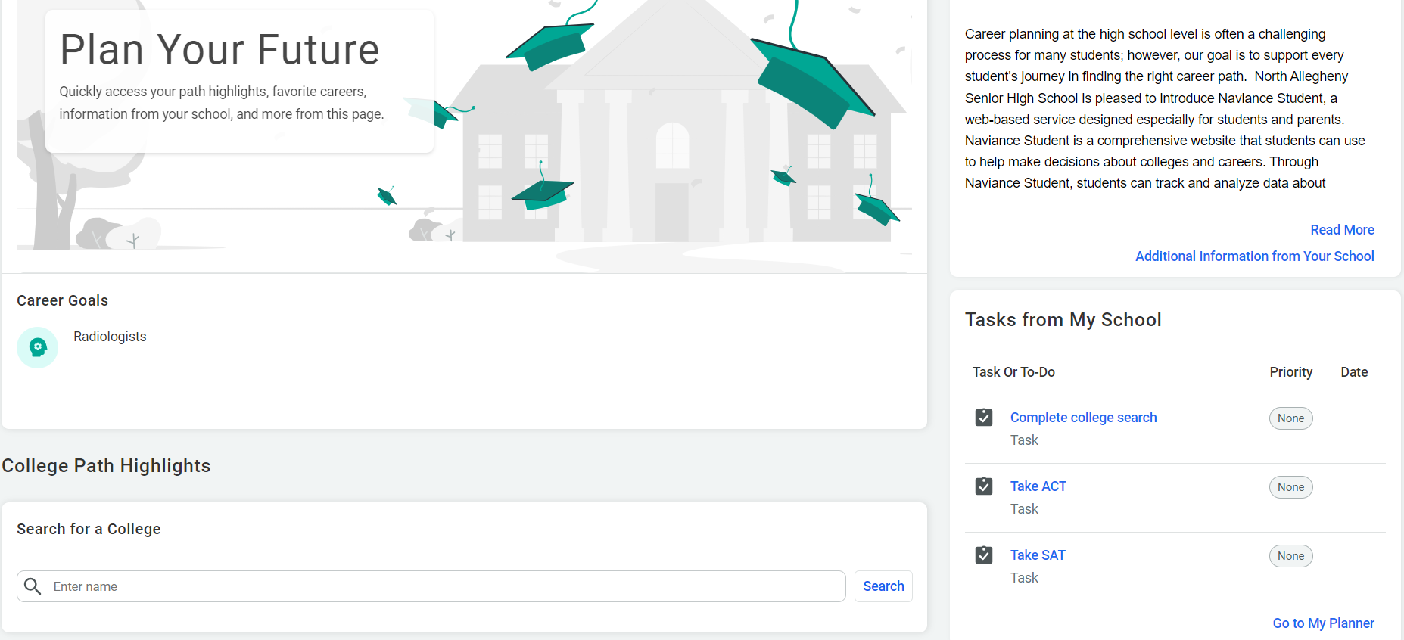
On the homepage, scroll down to find the “Tasks from My School” and click on “Go to My Planner.” You will see a list of tasks assigned to you by Bryan Kiggins. Please complete the tasks listed, including ones from your 9th grade year.

Slide 19
Thank You!
NAI - 2023-2024

